Slide 1

Vineet Kumar
Matric Number: N2203011H

Slide 2




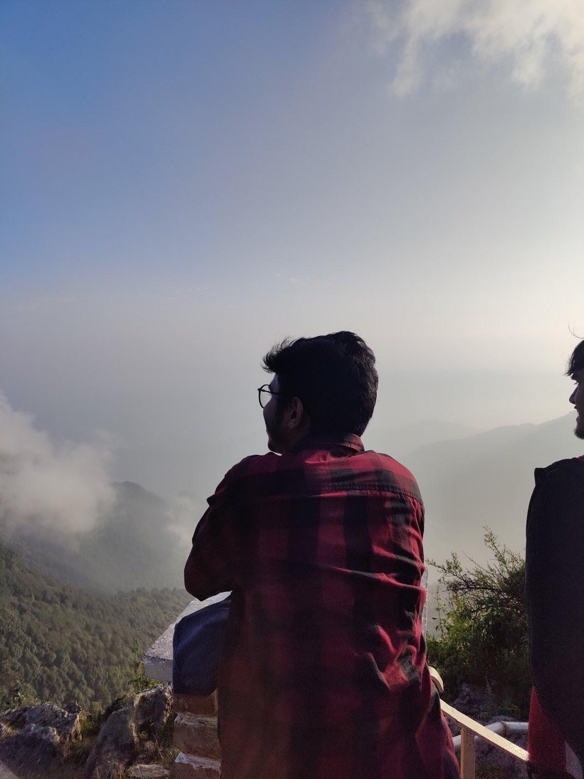
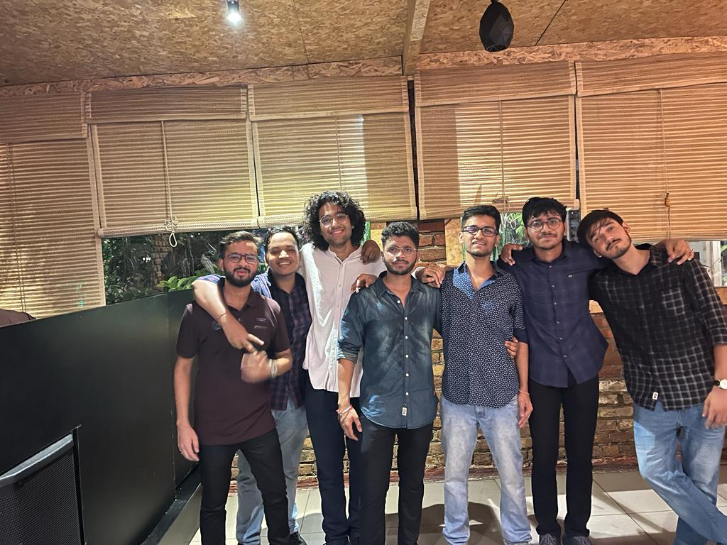
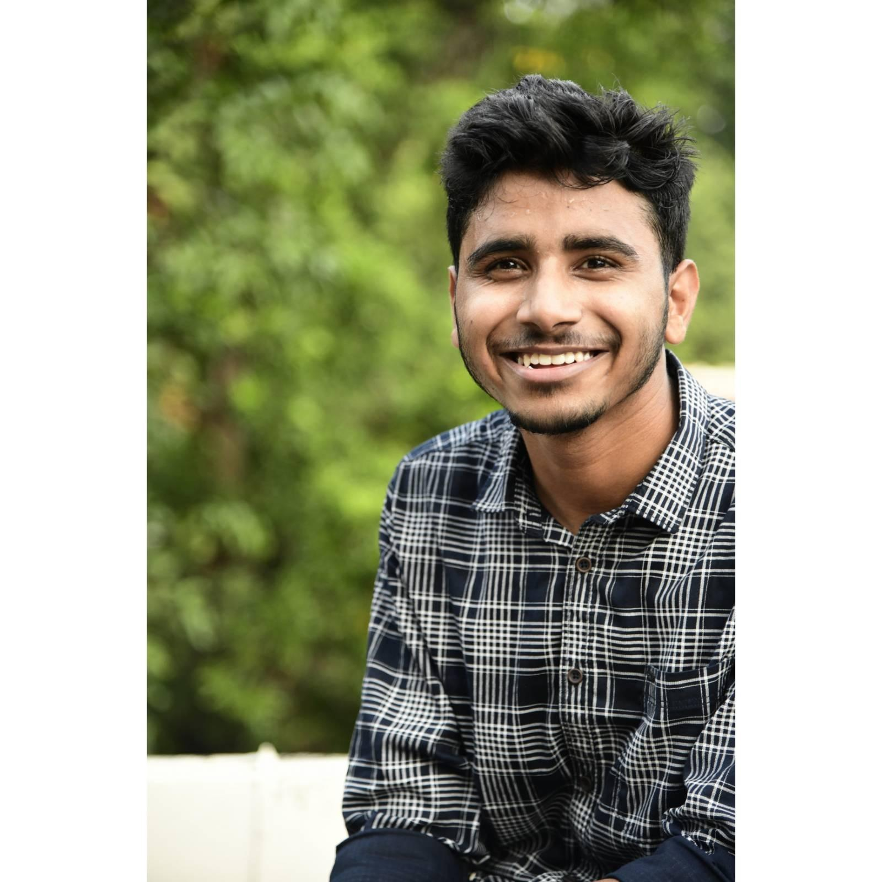
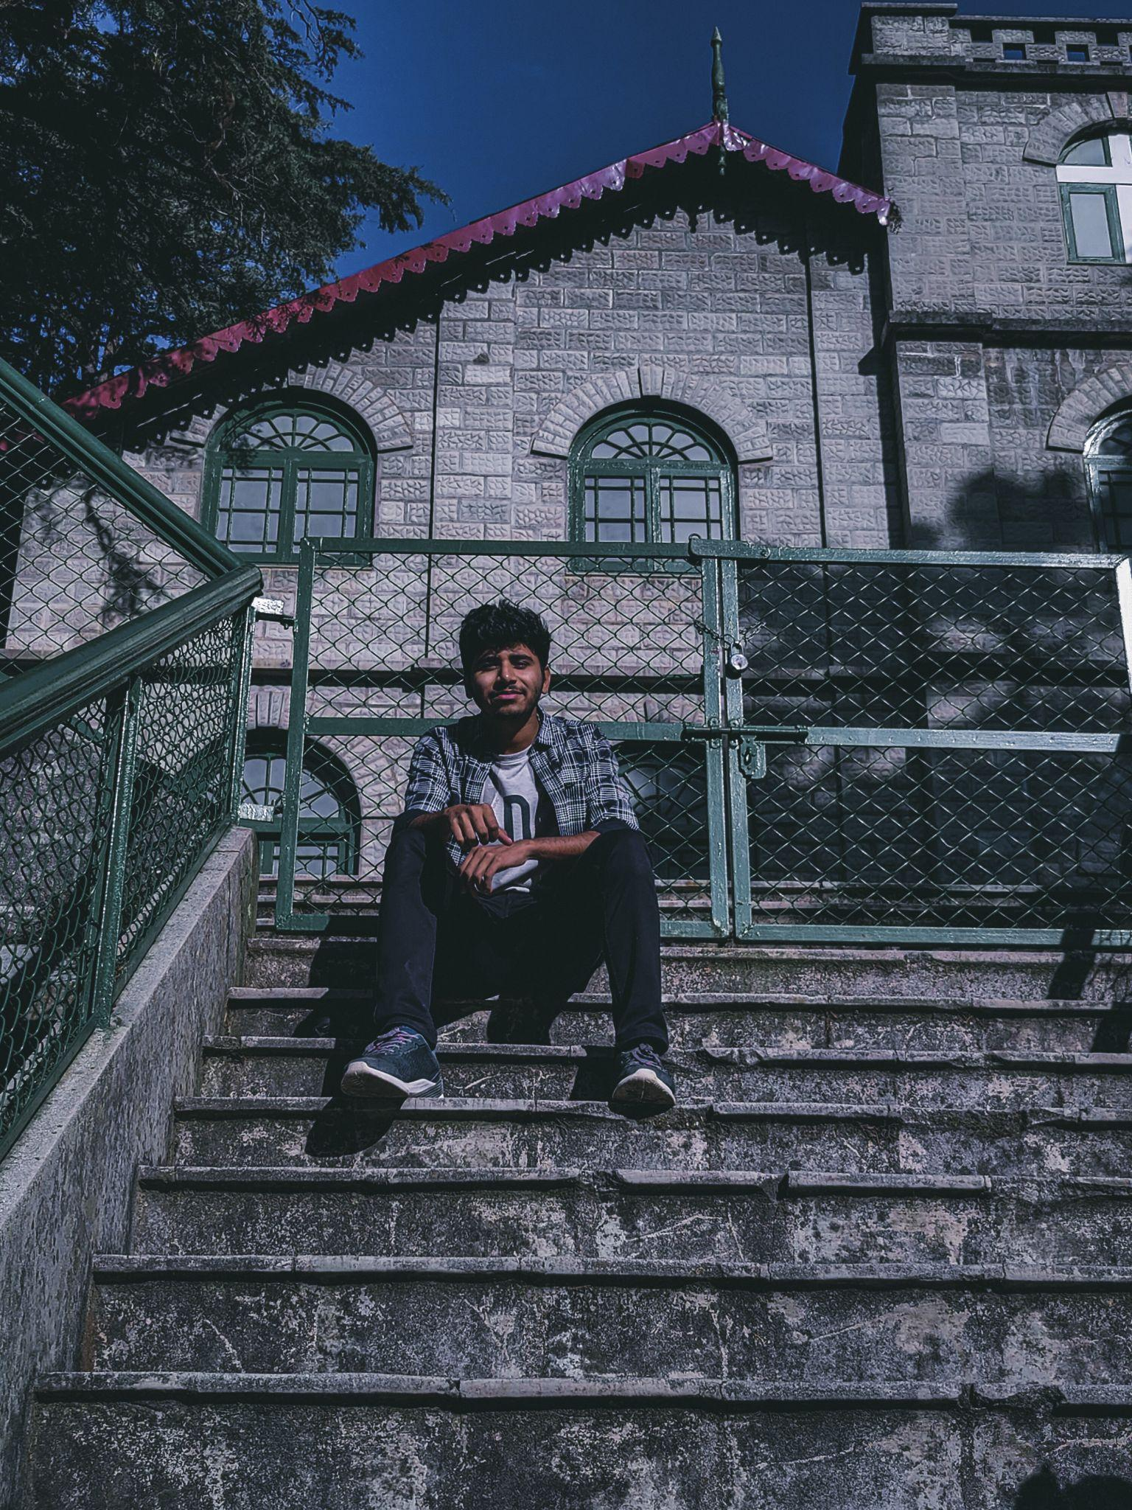





About Me
Hi!
I am Vineet Kumar,
I am 20 years old and I am an
undergraduate at IIT Kanpur
If you have stories to share,
I would love to hear them…
I also like to:
Listen to music
Eat
Talk with my friends
and most of all I love watching Anime and reading Mangas
I love doing digital art and photoshop, other than that you will find me either on Instagram or youtube in my free time
I Love to Travel and Dance…

